Slide 1
Fracking:
The Beginning of the End for
Natural Gas
By Daniel Gregory

Slide 2
What is Fracking?
http://www.youtube.com/watch?v=c8bZxH-N63M&feature=relmfu
(Exxon Mobil - Hydraulic Fracturing Explained)

Slide 3
History of Natural Gas
1,000 BC – The Oracle of Delphi
400 BC – Chinese first to use Natural Gas for fuel.
1785 – First use of Gas for illumination.
1870 – Pittsburg becomes first city to use Gas instead of coal.
1945 – Postwar technology allows building of interstate pipelines.
1985 – Deregulation of the gas industry begins.
2001 – Fracking begins.
2005 – Energy Policy Act of 2005 is passed with the “Haliburton Loophole”.

Slide 4
Properties of Natural Gas
Comprised mostly of methane
Easy to refine for use as fuel
Cleanest burning of all fossil fuels
No carbon dioxide emissions
Nitrous oxide is the only by-product

Slide 5
U.S. Natural Gas Mining History
Natural gas first discovered while mining for oil.
Before pipelines, natural gas use limited to “local use”.
Interstate pipeline expansion allowed for more widespread use of natural gas.

Slide 6
Government Regulation
Early natural gas market considered a “monopoly”.
Government regulations to protect consumers began in the 1940’s.
Over-regulation led to changes in policy in early 1980’s.
Dwindling reserves lead to further deregulation in the Energy Policy Act of 2005.
http://www.youtube.com/watch?v=QRNRHdVwRFI
(NY State Legislature Testimony)

Slide 7
The Fracking Controversy Begins
Dwindling supply and increasing demand = desperate measures.
The “Haliburton Loophole”.
Fracking operations exempted from Clean Water Act and Clean Air Act.
Disclosure of chemicals used in fracking also exempted.

Slide 8
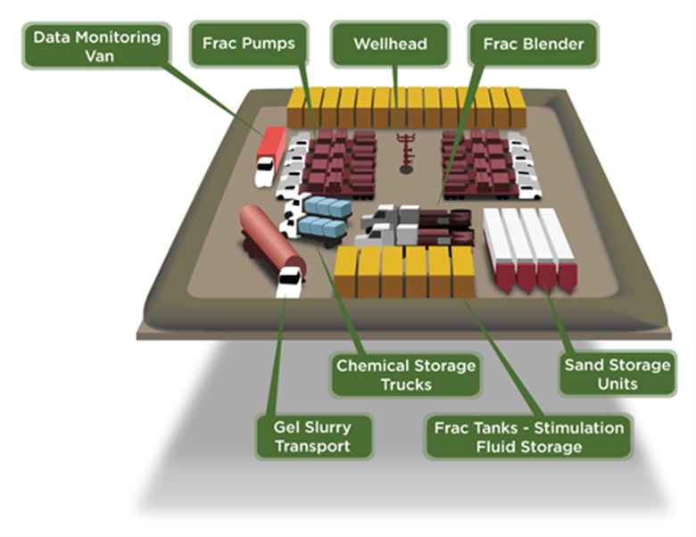
Chemicals Associated with Fracking
2-Dibromo-3-Nitrilopropionamide - Algecide
2-butoxyethanol - Carcenogin
2-methyl-4-isothiazolin-3-one - Biocide
Acetic Acid - Vinegar (weak acid)
Acetic Anhydride - Explosive when mixed with H Peroxide
Alphatic acid
Polyglycol Ether - Surfactant (lowers H2O surface tension)
Ammonia Sulfate - Breaks down into ammonia
Aromatic Hydrocarbon - Benzine
Aromatic Ketones - Benzine family
Boric Acid (Boron) - Pesticide
Dazomet - Pesticide
Ethylene Glycol - Antifreeze
Formaldehyde - Preservative
Hydrogen Peroxide - see Acetic Anydride
Hydrochloric Acid - Strong acid
Isopropal Alcohol - Cleaning agent
Methanol - Toxic, can cause blindness
Monoethanolamine - Toxic to CNS, Liver, Kidneys, Lungs
Polyethenine Glycol - Surfactant
Potassium Hydroxide - Drain Cleaner
Sodium Chloride - Used as drilling fluid
Sodium Hydroxide - Caustic Soda, causes chemical burns
Tetramethylammonium Chloride - Harmful if inhaled, Fatal if swallowed

Slide 9
The Real Fracking Operation
First 1,000’ of gas well is lined with concrete to prevent leakage.
Trucks deliver water and fracking chemicals to drilling site.
Shale is fractured and the water/chemical mix is pumped in.
Natural gas flows back up the well to the surface, along with the toxic water/chemical mix.
The untreated water is “stored” in an open pit until it can be hauled away.
http://www.youtube.com/watch?v=X8du6pQbvyo&feature=relmfu
(Exxon Mobil public service commercial)

Slide 10
Documented Harm to People and the Environment
Colorado:
Laura Amos: Contaminated well water
Susan Wallace-Babb: Exposure to fracking chemicals
Texas:
Contaminants found in air and water samples in town of Dish
Pennsylvania:
Cement casings in 20 gas wells fail, contaminating ground water for entire town with methane.
http://www.youtube.com/watch?v=ptlVkScxpfA
(Gasland)

Slide 11
Bibliography
Colborn, T., Kwiatkowski, K., Schultz, K., & Bachran, M. (2011, September 20).
Natural Gas Operations from a Public Health Perspective. International
Journal of Human and Ecological Risk Assessment. 17. Retrieved from
http://www.tandfonline.com/doi/abs/10.1080/10807039.2011.605662
Howarth, R. W., Ingraffea, A., & Engelder, T. (2011, September 15). Should Fracking
Stop?. Nature, 477. Retrieved from http://www.nature.com/nature/journal/v477/n7364/full/477271a.html
Lustgarten, A. (2011, September 29). The Trouble With Health Problems Near
Gas Fracking. Retrieved from
http://www.npr.org/2011/09/29/140872251/the-trouble-with-health-problems-near-gas- fracking
MacAvoy, P. W. (2000). The Natural Gas Market: Sixty Years of Regulation and
Deregulation. New Haven, CT: Yale University Press.
Nersesian, R. L. (2007). Energy for the 21st Century: A Comprehensive Guide to
Conventional and Alternative Sources. Armonk, NY: M.E. Sharpe, Inc.
Parker Waichman Alonso LLP. (2011). Hydraulic Fracturing- Fracking Contamination
Lawsuits. Retrieved from
http://www.yourlawyer.com/topics/overview/hydraulic_fracturing_fracking?gclid=CPTa 7-SHz6sCFcm77QodRx1yUQ
Roach, J. (2001, August 14). Delphic Oracle’s Lips May Have Been Loosened By
Gas Vapors. Retrieved from
http://news.nationalgeographic.com/news/2001/08/0814_delphioracle.html
Secretary of Energy Advisory Board Shale Gas Subcommitte. (2011, August 11).
The SEAB Shale Gas Production Subcommitte Ninety-Day Report.
Retrieved from
http://www.shalegas.energy.gov/resources/081111_90_day_report.pdf
Soraghan, M. (2011, May 13). Baffled About Fracking? You’re Not Alone.
Retrieved from
http://www.nytimes.com/gwire/2011/05/13/13greenwire-baffled-about-fracking-youre- not-alone-44383.html?pagewanted=all
TEDX The Endocrine Disruptor Exchange. (2011). Chemicals in Natural Gas Operations.
Retrieved from
http://www.endocrinedisruption.com/chemicals.introduction.php
Vaughn, J. (2007). Conflicts Over Natural Resources. Santa Barbara, CA: ABC-CLIO, Inc.
Vaughn, J. (2007). Environmental Politics: Domestic and Global Dimensions.
Belmont, CA: Thompson Wadsworth.

